Slide 1
Colour balance and contrast stretching for sand-dust image enhancement
Shashwat singh (22EE65R04)
K . Pavan kalyan raju (22EE65R07)
B.Govind reddy (22EE65R25)

Slide 2
Motivation
The increasingly frequent sand-dust weather in the inland areas seriously affects outdoor vision applications, especially autonomous vehicles and security monitoring. To moderate the image’s color cast and poor contrast caused by sand-dust weather, an effective approach is proposed to enhance the sand-dust images.

Slide 3
Reference paper
Hua, Z., Qi, L., Guan, M., Su, H., Sun, Y.: Colour balance and contrast stretching for sand-dust image enhancement. IET Image Process. 16, 3768–3780 (2022). https://doi.org/10.1049/ipr2.1259.

Slide 4
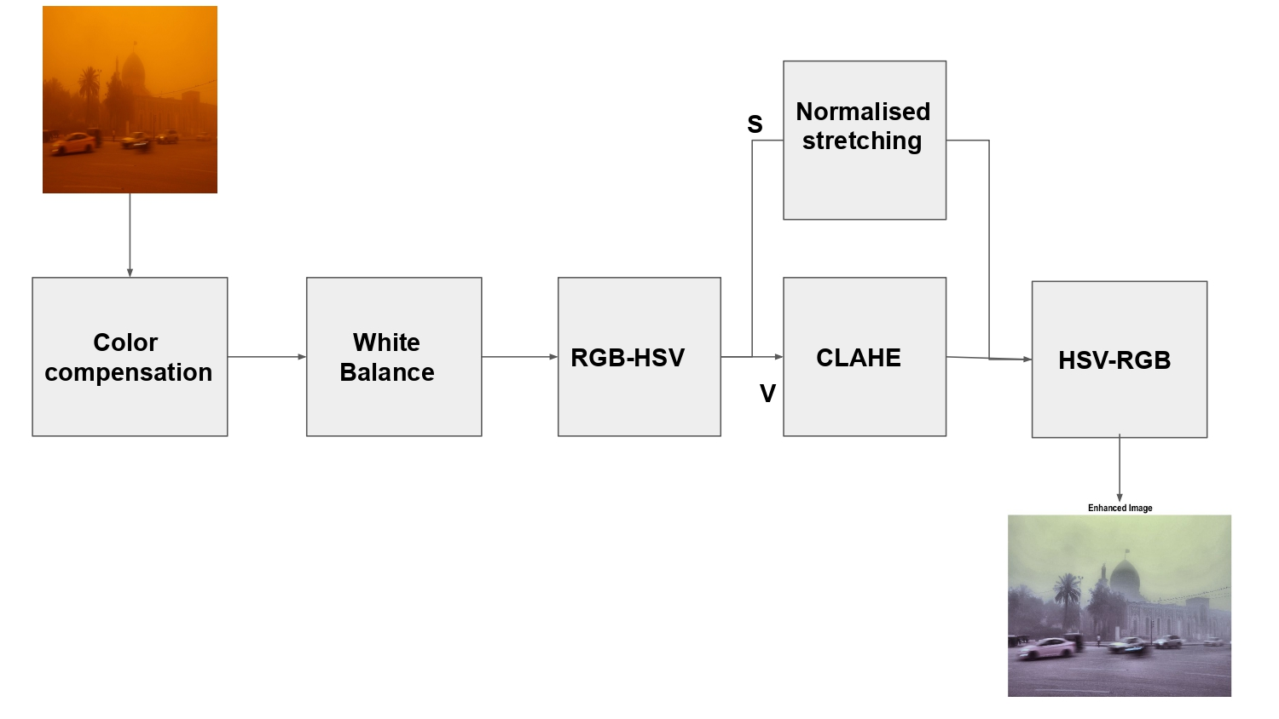
Methodology
Proposed methodology

Slide 5
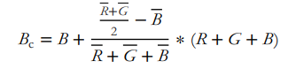
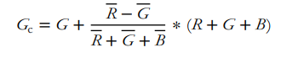
Color compensation for blue and green channel to remove yellowish nature .

Slide 6
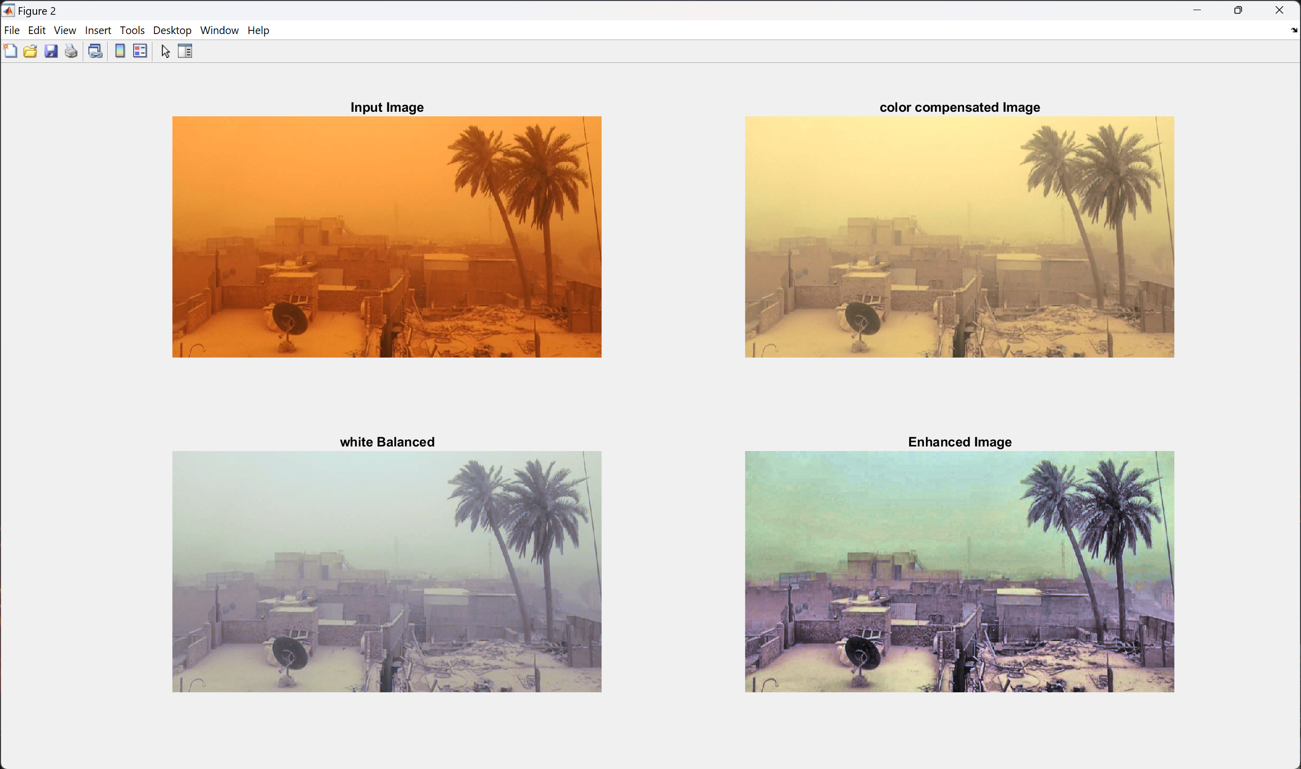
Results and Discussion

Slide 7
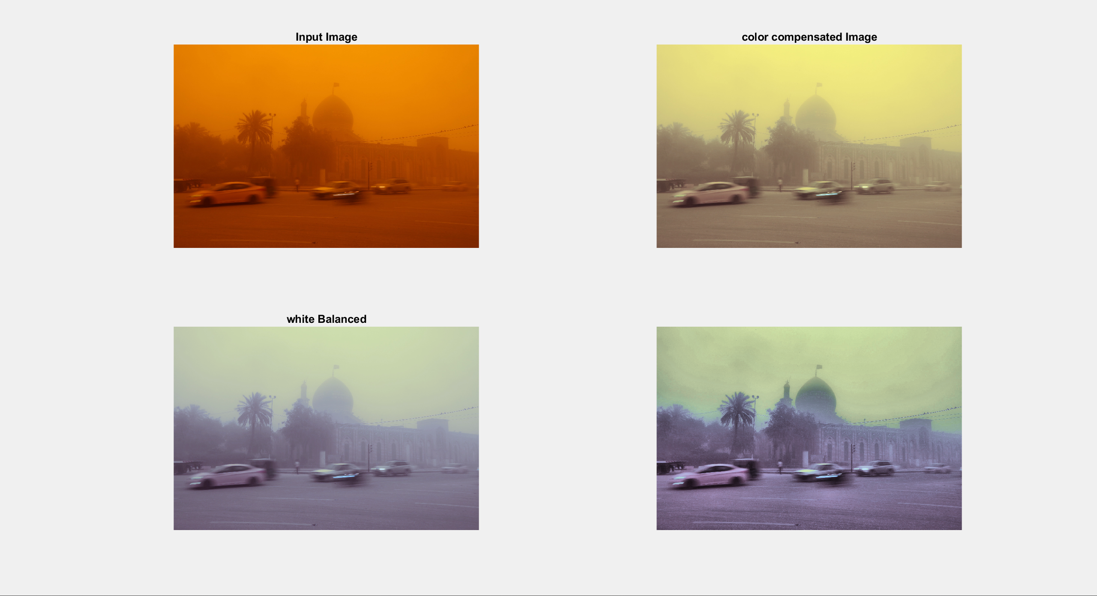

Slide 8
